Slide 1

Standard Operating Procedure
May 10, 2018

Slide 2


Our Journey
In 2017, organization and management changes in IT drove considerably more contract volume and exposed deficiencies in the procurement process
After gathering customer sentiment, we heard that:
The process takes too long
It’s hard to get status
Data in Ariba is bad and unreliable
Mr. Moran said, “…the future belongs to those who prepare for it.”
Heeding Mr. Moran’s advice, we set out to “do it better” by sparking change in Procurement
May 10, 2018
2

Slide 3
Looking Back
June
May
Production Deployment
April
Test & Transition
March
Control Plan
Reinforcement Plan
Rolled-Up the Sleeves
Workstreams:
SOP ● PLC ● Reporting
Error Proofing ● QA/QC
Rationalize Data Elements
Change Mgt ● VSM
Ariba Enhancements
Training
February
Understand the Process
Workstreams:
SOP ● PLC ● Reporting
Error Proofing ● QA/QC
Rationalize Data Elements
Change Mgt ● VSM
Ariba Enhancements
January
Define the Problem
Activity Tracking
Workstreams:
SOP ● PLC ● Reporting
Error Proofing ● QA/QC
Rationalize Data Elements
Change Mgt ● VSM
Ariba Enhancements
Process Improvement Strategy
Pizza Simulation
SIPOC
Kano Model
Launched Work Streams
Internal Survey
SWOT Analysis
Plan
Do
Check
Act
May 10, 2018
3

Slide 4
Leaning on Our Core Values
Accountability
Communication
JM Family Core Values
Innovation
Cooperation
Consideration
May 10, 2018
4

Slide 5
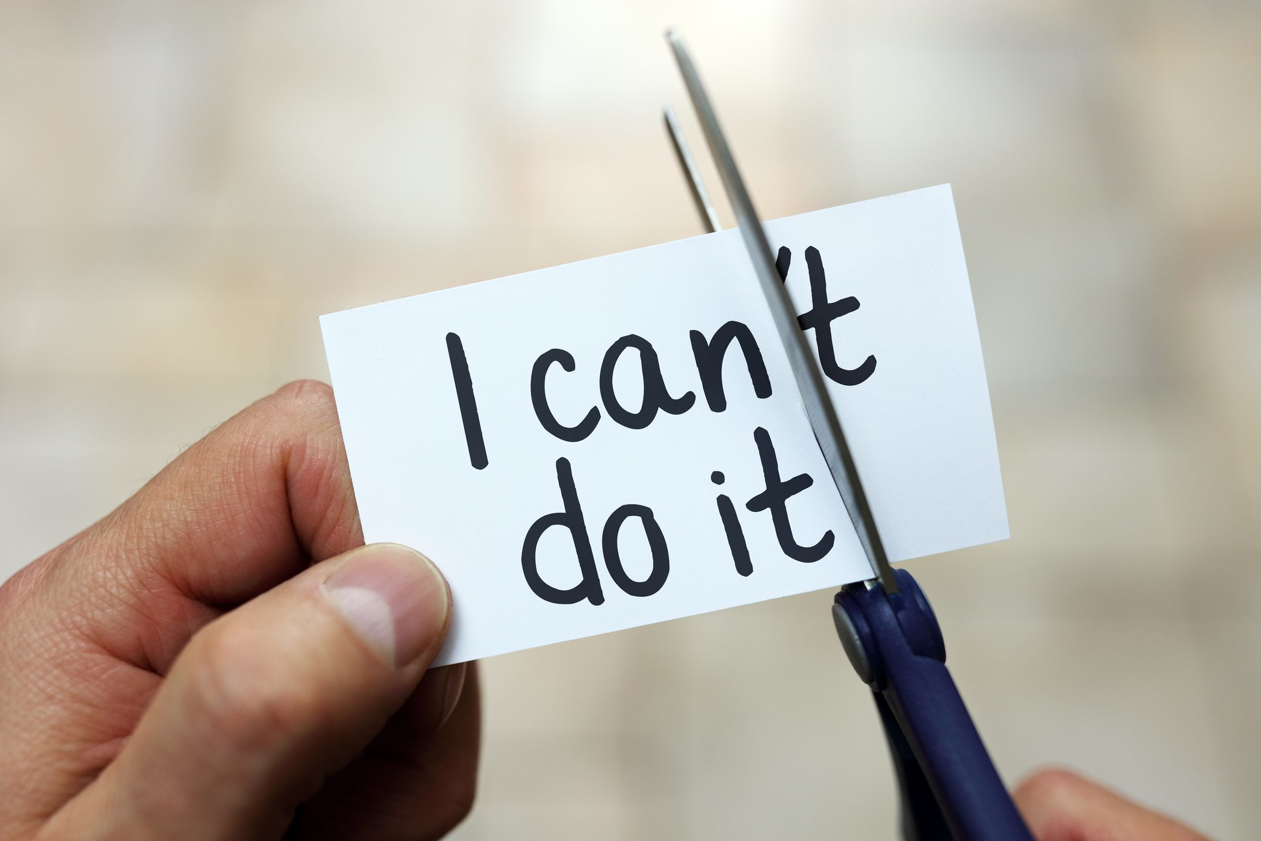
Leaning on Our Core Values
Accountability
Innovation
Consideration
Cooperation
Communication
May 10, 2018
4

Slide 6

Accountability
Accountability was a primary focus area for PDCA cycle #1
Rather than pointing the finger and blaming others, we committed ourselves to fixing the portion of the process we control
We launched nine work streams to improve the process
May 10, 2018
5

Slide 7
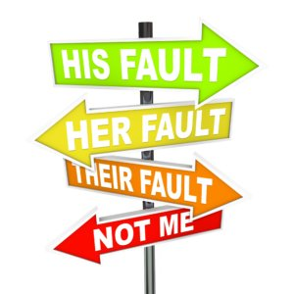
Accountability
Accountability was a primary focus area for PDCA cycle #1
Rather than pointing the finger and blaming others, we committed ourselves to fixing the portion of the process we control
We launched nine work streams to improve the process
May 10, 2018
5

Slide 8

Accountability
Accountability was a primary focus area for PDCA cycle #1
Rather than pointing the finger and blaming others, we committed ourselves to fixing the portion of the process we control
We launched nine work streams to improve the process
May 10, 2018
5

Slide 9
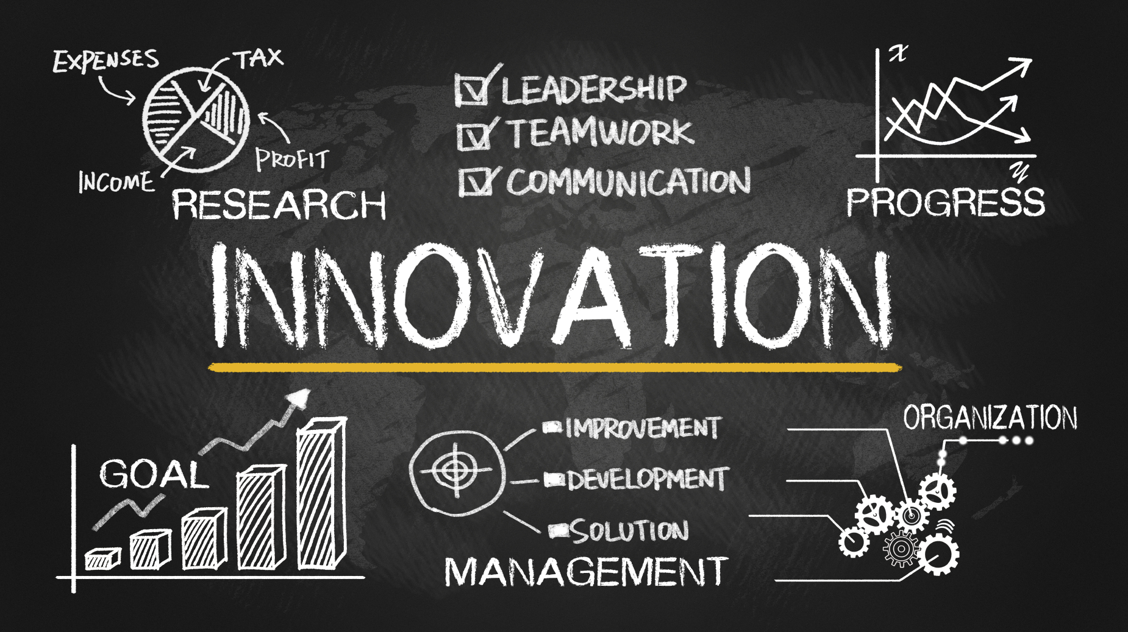
Innovation
Set an atmosphere of creative problem solving and empowered the team to question the status quo
As we examined our process, system, & data no suggestion was too small or too silly
Eliminated unnecessary fields & unused reports, activated unused modules, and established a standard work
May 10, 2018
6

Slide 10

Innovation
Set an atmosphere of creative problem solving and empowered the team to question the status quo
As we examined our process, system, & data no suggestion was too small or too silly
Eliminated unnecessary fields & unused reports, activated unused modules, and established a standard work
May 10, 2018
6

Slide 11
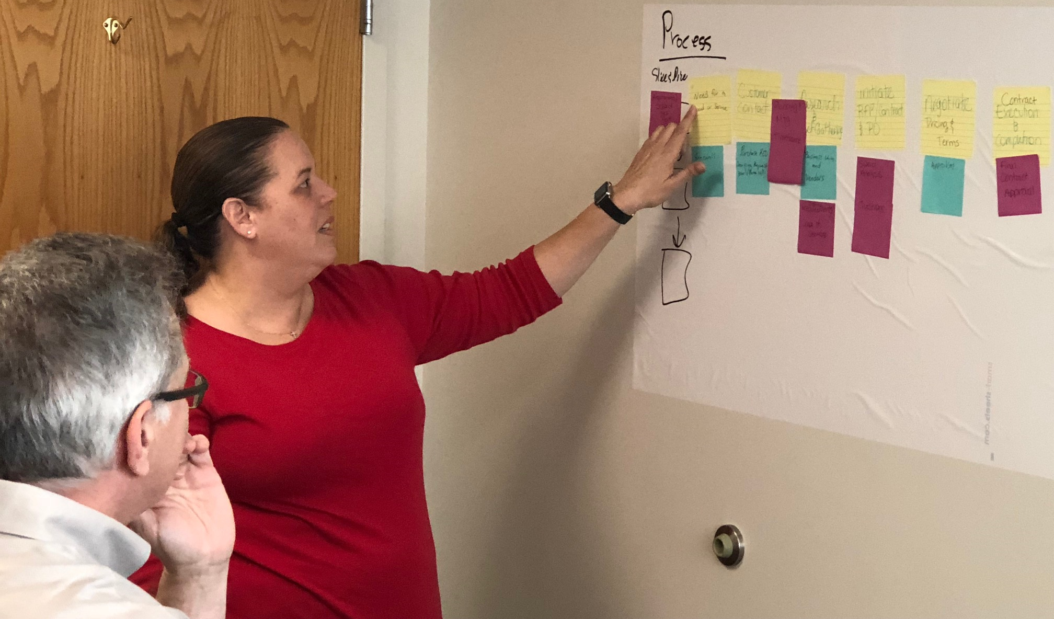
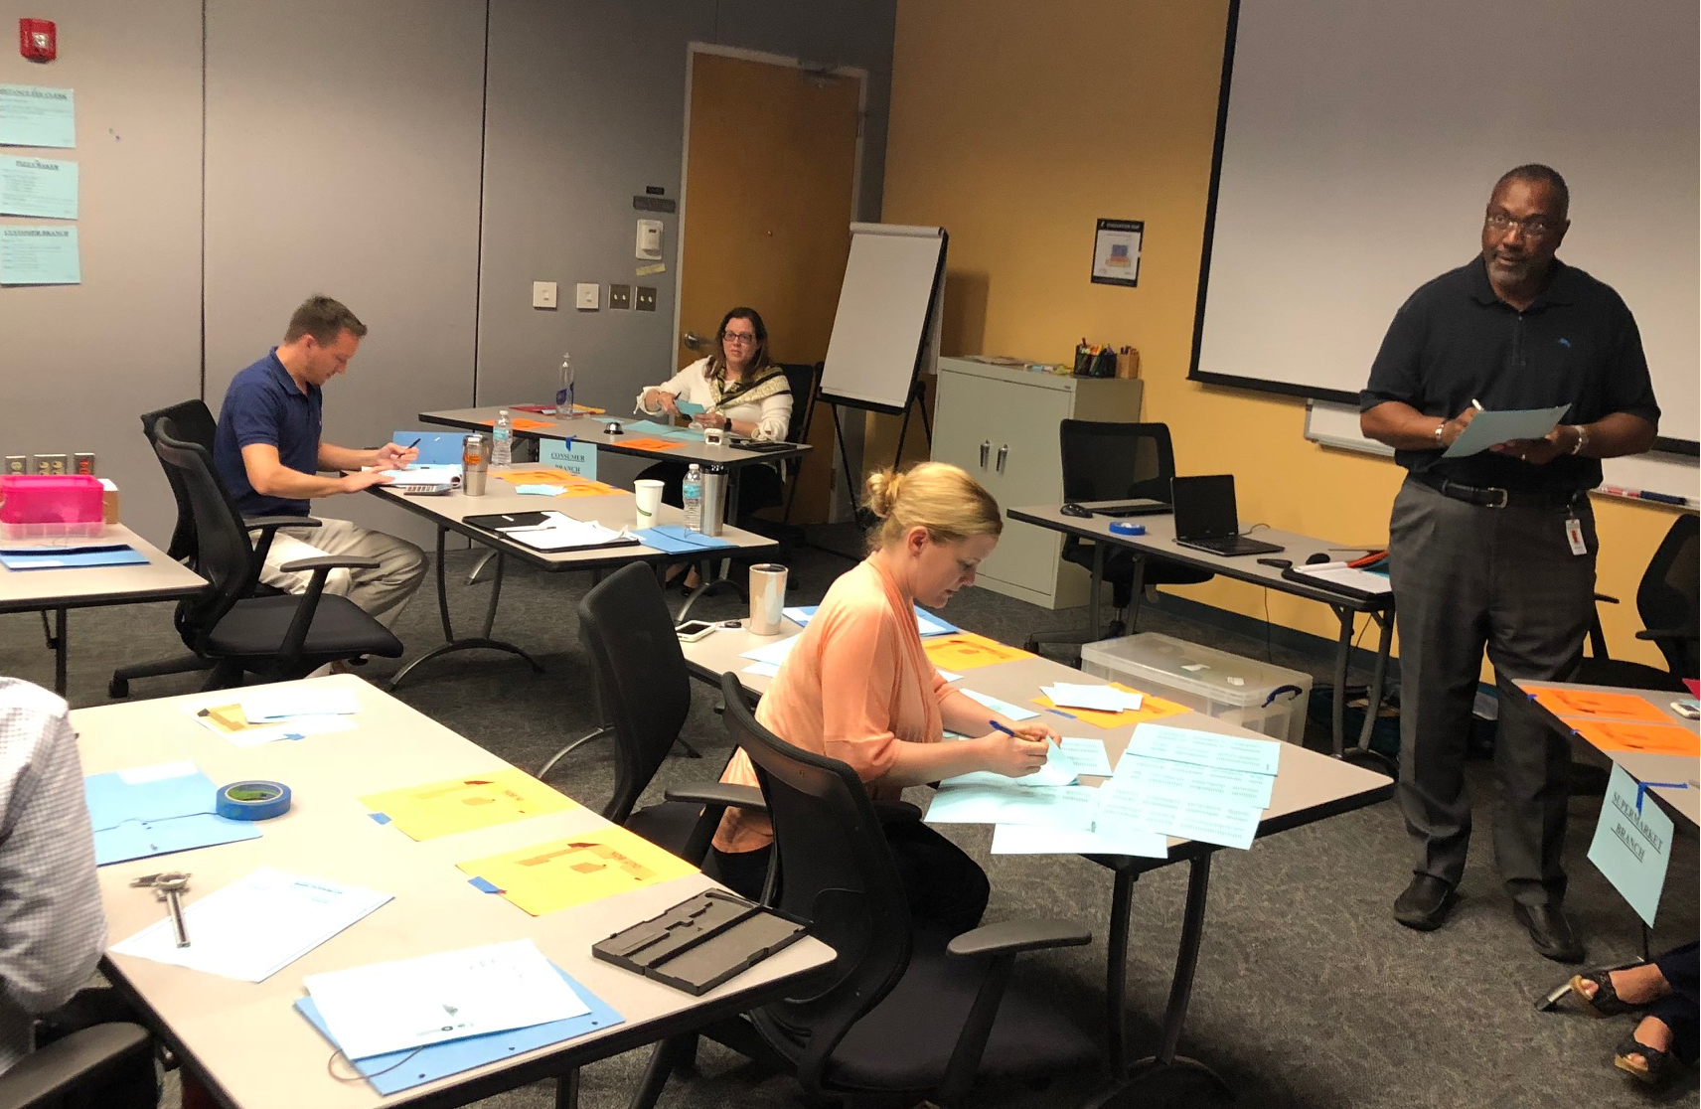
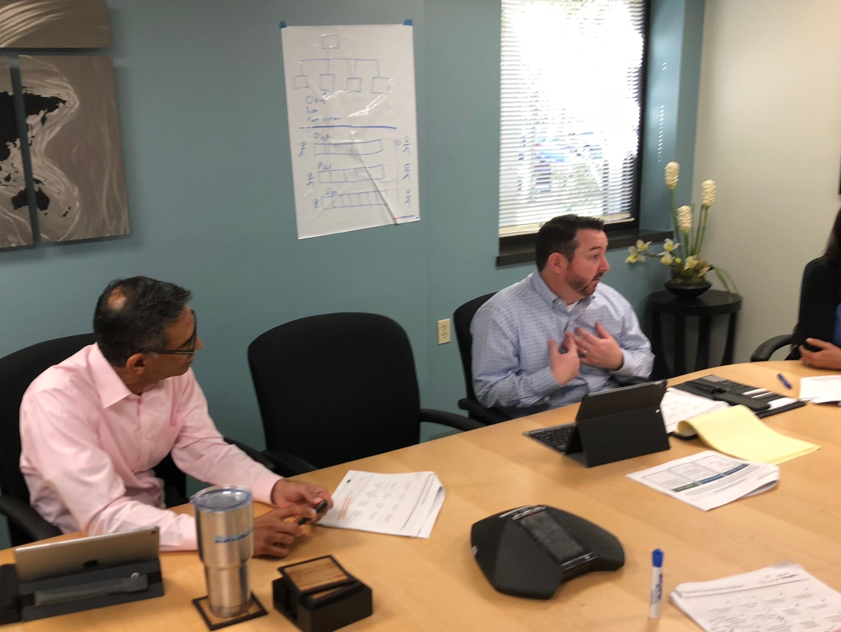
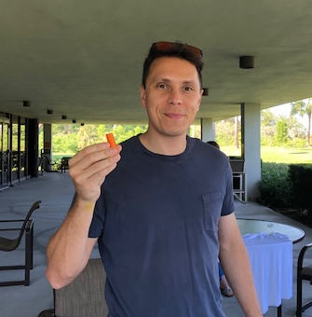
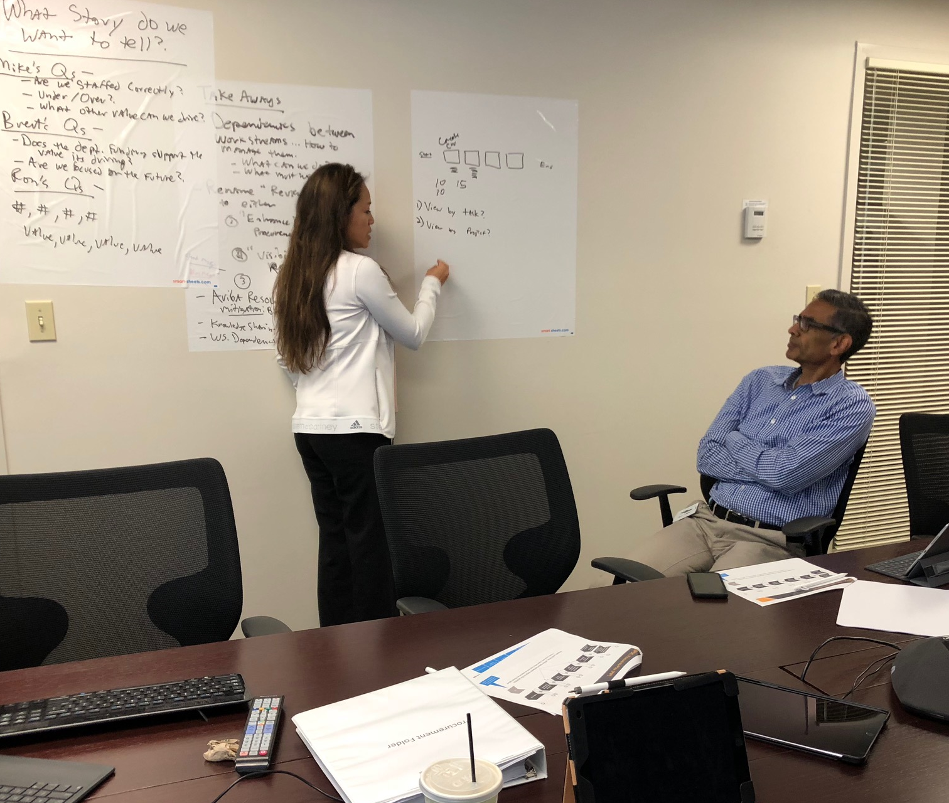
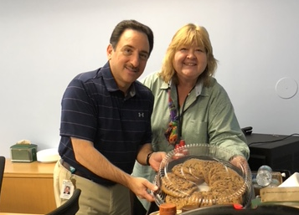
Consideration
We placed the customer at the center and sought to understand their needs
Used the Kano model to categorize requirements: “must-have”, “nice-to have”, and “delighters”
Considered the associates and how to support each of you through the changes
Remember the stress-relieving Fun Events?
Mar 2 – Wawa ● Mar 16 – Mocktail Party
Mar 30 tie dye t-shirts ● Apr 4 Little Havana
April 20 ice cream social
May 10, 2018
7

Slide 12

Cooperation
While we experienced creative tensions, we learned how to compromise and support each other
We also asked for your flexibility as we placed you on work streams outside your natural comfort zone
Finally, we asked that you to reach for “better” rather than “best” or “perfect”
May 10, 2018
8

Slide 13

Cooperation
While we experienced creative tensions, we learned how to compromise and support each other
We also asked for your flexibility as we placed you on work streams outside your natural comfort zone
Finally, we asked that you to reach for “better” rather than “best” or “perfect”
May 10, 2018
8

Slide 14
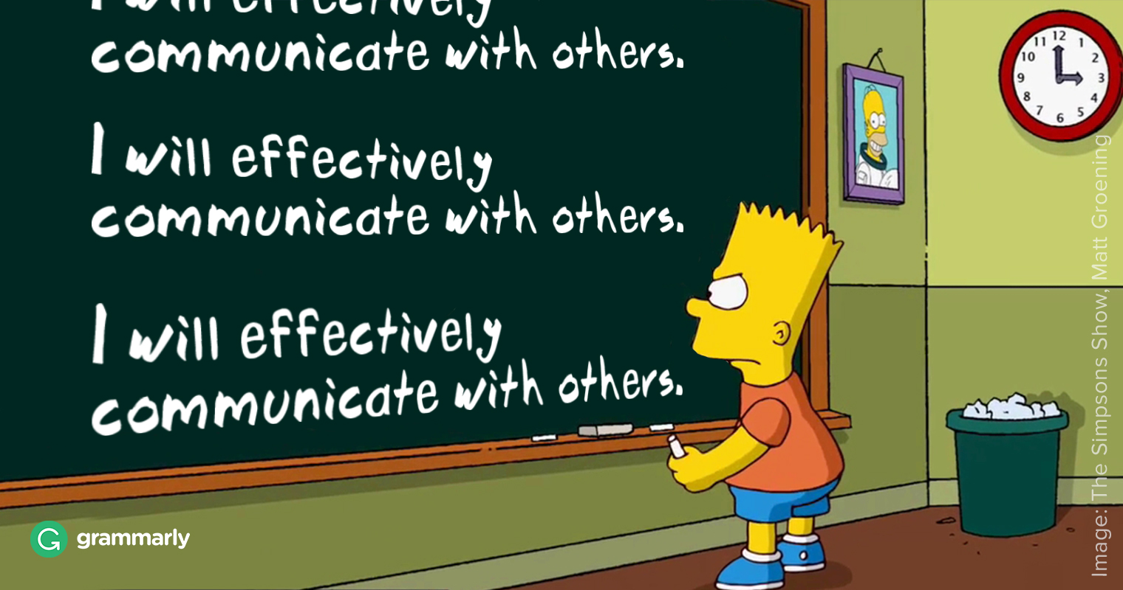
Communication
While we experienced creative tensions, we learned how to compromise and support each other
We also asked for your flexibility as we placed you on work streams outside your natural comfort zone
Finally, we asked that you to reach for “better” rather than “best” or “perfect”
May 10, 2018
9

Slide 15

Communication
While we experienced creative tensions, we learned how to compromise and support each other
We also asked for your flexibility as we placed you on work streams outside your natural comfort zone
Finally, we asked that you to reach for “better” rather than “best” or “perfect”
May 10, 2018
9

Slide 16

Communication
While we experienced creative tensions, we learned how to compromise and support each other
We also asked for your flexibility as we placed you on work streams outside your natural comfort zone
Finally, we asked that you to reach for “better” rather than “best” or “perfect”
May 10, 2018
9

Slide 17
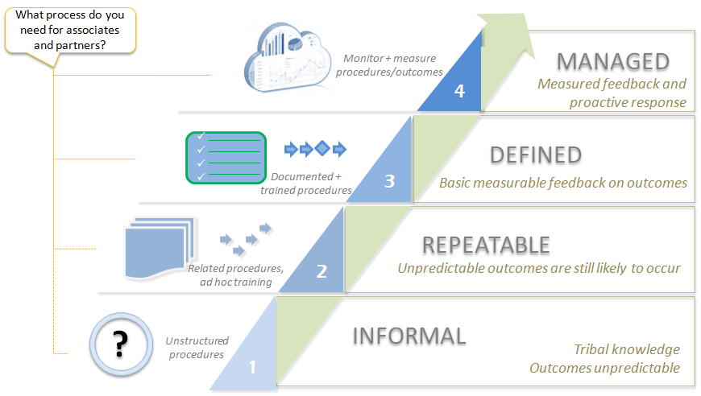
Value of Confidence
May 10, 2018
10

